Slide 1
Topics to be covered
Binomial Theorem
Pascal’s Triangle

Slide 2
Binomial Coefficients and Combinatorial Identities
At first glance the expression (a+b)^{n} does not have much to do with combinations
In fact, we can obtain the formula for the expansion of (a+b)^{n} by using the formula for the number of r-combinations of n objects.
Consider that
(a+b)^{n} = (a+b)(a+b) . . .(a+b)
n factors

Slide 3
Binomial Coefficients and Combinatorial Identities
Consider computing (a+b)³
Selection from First Factor (a+b) | Selection from Second Factor (a+b) | Selection from Third Factor (a+b) | Product of Selections
a | a | a | aaa = a³
a | a | b | aab = a²b
a | b | a | aba = a²b
a | b | b | abb = ab²
b | a | a | baa = a²b
b | a | b | bab = ab²
b | b | a | bba = ab²
b | b | b | bbb = b³

Slide 4
Binomial Coefficients and Combinatorial Identities
(a+b)³ = (a+b)(a+b)(a+b)
= aaa + aab + aba + abb + baa + bab + bba + bbb
= a³ + a²b+ a²b +ab² + a²b +ab² +ab² + b³
= a³ + 3a²b + 3ab² + b³
^{Recall that n = 3}
A term of the form a^{n-k}b^{k} arises from choosing b from k factors, and a from n-k factors.
Since C(n,k) counts the number of ways of selecting k things from n items.
Thus each a^{n-k}b^{k} appears C(n,k) times.

Slide 5
Binomial Coefficients and Combinatorial Identities
It follows that
(a+b)^{n} = (a+b)(a+b) . . .(a+b)
n factors
= C(n,0)a^{n}b⁰ + C(n,1)a^{n-1}b¹ + C(n,2)a^{n-2}b²
+ . . . + C(n,n-1)a¹b^{n-1} + C(n,n)a⁰b^{n}
This result is known as the
Binomial Theorem
The Binomial Theorem gives a formula for the coefficients in the expansion of (a+b)^{n}.

Slide 6
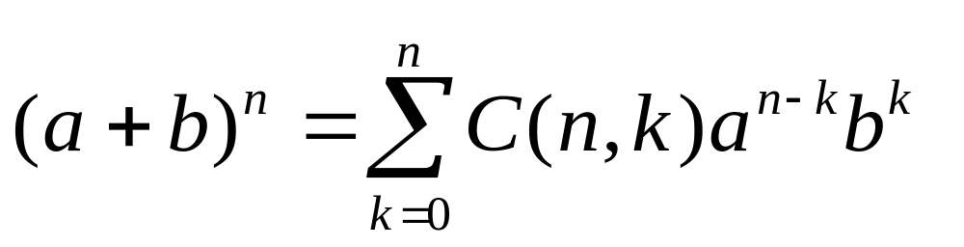
Binomial Theorem
Binomial Theorem
If a and b are real numbers and n is a positive integer, then
The numbers C(n,k) are known as binomial coefficients because they appear in the expanded formula of the binomial (a + b) raised to a power.

Slide 7
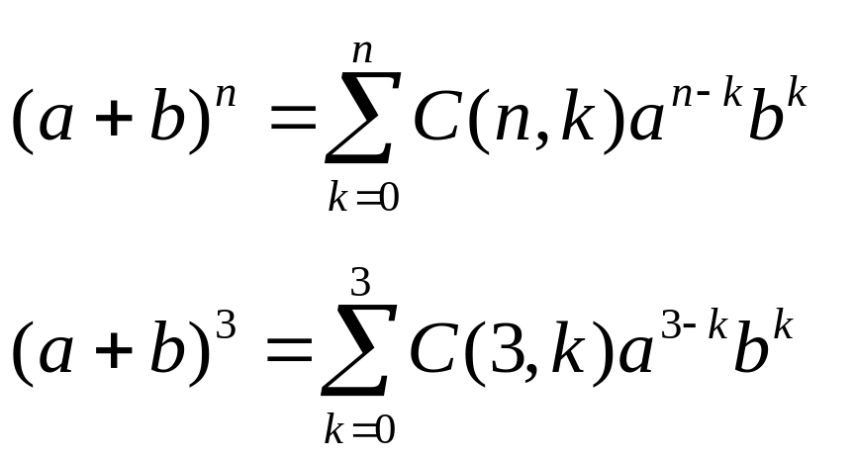
Binomial Theorem
^{Recall that when n = 3}
(a+b)³ = (a+b)(a+b)(a+b)
= a³ + 3a²b + 3ab² + b³
Now using the formula
Substituting n = 3

Slide 8
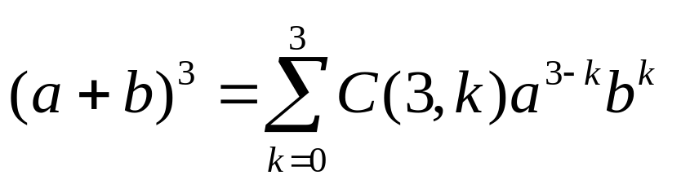
Binomial Theorem
Using the Binomial Theorem.
=C(3,0)a³b⁰ + C(3,1)a³⁻¹b¹ + C(3,2)a³⁻²b²
+ C(3,3)a³⁻³b³
= 1a³ + 3a²b + 3ab² + 1b³
= a³ + 3a²b + 3ab² + b³

Slide 9
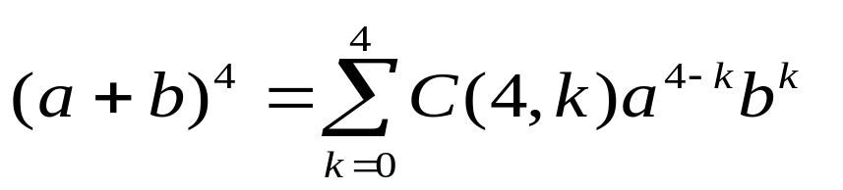
Binomial Theorem – Example 1
Expand (3x - 2y)⁴ using the Binomial Theorem.
(3x - 2y)⁴ = (a + b)⁴
= C(4,0)a⁴b⁰ + C(4,1)a⁴⁻¹b¹ + C(4,2)a⁴⁻²b²
+ C(4,3)a⁴⁻³b³ + C(4,4)a⁴⁻⁴b⁴
= C(4,0)(3x)⁴(-2y)⁰ + C(4,1)(3x)³(-2y)¹ + C(4,2)(3x)²(-2y)²
+ C(4,3)(3x)¹(-2y)³ + C(4,4)(3x)⁰(-2y)⁴
= 1(3x)⁴(-2y)⁰ + 4(3x)³(-2y)¹ + 6(3x)²(-2y)²
+ 4(3x)¹(-2y)³ + 1(3x)⁰(-2y)⁴
= 3⁴x⁴ + 4(3³)x³(-2y) + 6(3²)x²(-2)²y² + 4(3x)(-2)³y³ + (-2)⁴y⁴
= 81x⁴ – 216x³y + 216x²y² – 96xy³ + 16y⁴

Slide 10
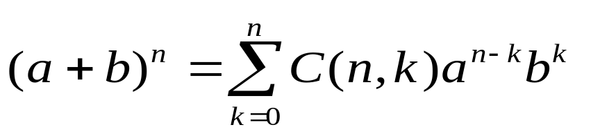
Binomial Theorem – Example 2
Find the coefficient of a⁵b⁴ in the expansion (a+b)⁹
Considering
The term involving a⁵b⁴ arises in the Binomial Theorem by taking n=9 and k=4:
C(n,k)a^{n-k}b^{k} = C(9,4)a⁵b⁴
= 126a⁵b⁴
Thus the coefficient of a⁵b⁴ is 126

Slide 11
Pascal’s Triangle
We can write the binomial coefficients in a triangular form known as Pascal’s triangle…
1
1 1
1 2 1
1 3 3 1
1 4 6 4 1
1 5 10 10 5 1
. . .
. . .

Slide 12
Pascal’s Triangle
Also shown as a table
n\k | 0 | 1 | 2 | 3 | 4 | … | k-1 | k
0 | 1
1 | 1 | 1
2 | 1 | 2 | 1
3 | 1 | 3 | 3 | 1
4 | 1 | 4 | 6 | 4 | 1
. | . | . | . | . | . | …
n-1 | ^{n-1}C₀ | ^{n-1}C₁ | ^{n-1}C₂ | ^{n-1}C₃ | ^{n-1}C₄ | … | ^{n-1}C_{k-1} | ^{n-1}C_{k}
n | ^{n}C₀ | ^{n}C₁ | ^{n}C₂ | ^{n}C₃ | ^{n}C₄ | … | ^{n}C_{k-1} | ^{n}C_{k}
n+1 | ^{n+1}C₀ | ^{n+1}C₁ | ^{n+1}C₂ | ^{n+1}C₃ | ^{n+1}C₄ | … | ^{n+1}C_{k-1} | ^{n+1}C_{k}
+
=
+
=

Slide 13
Pascal’s Triangle
Pascal’s Triangle
The border consists of 1’s
Any interior value is the sum of the two numbers above it

Slide 14
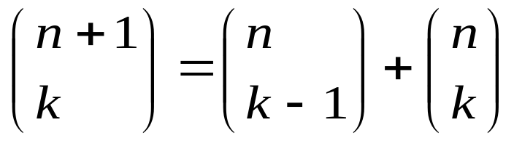
Pascal’s Triangle
Pascal’s Triangle Theorem
C(n+1,k) = C(n,k-1) + C(n,k)
for 1 ≤ k ≤ n
Also written as…
Pascal’s Identity
Let n and k be positive integers with n ≥ k, Then

Slide 15
Pascal’s Triangle
Pascal’s Triangle Theorem
C(n+1,k) = C(n,k-1) + C(n,k)
for 1 ≤ k ≤ n
Recall…
. . .
1 3 3 1
1 4 6 4 1
1 5 10 10 5 1
For the subsequent row
C(5+1,k) = C(5,k-1) + C(5,k) for 1 ≤ k ≤ 5

Slide 16
Pascal’s Triangle
1 5 10 10 5 1
For the subsequent row
C(5+1,k) = C(5,k-1) + C(5,k) for 1 ≤ k ≤ 5
Continuing…
C(5+1,1) = C(5,1-1) + C(5,1) = 1+5 = 6
C(5+1,2) = C(5,2-1) + C(5,2) = 5+10 = 15
C(5+1,3) = C(5,3-1) + C(5,3) = 10+10 = 20
C(5+1,4) = C(5,4-1) + C(5,4) = 10+5 = 15
C(5+1,5) = C(5,5-1) + C(5,5) = 5+1 = 6
Therefore…
1 6 15 20 15 6 1

Slide 17
Pascal’s Triangle – Example 1
Find the next row of Pascal’s triangle given the row
1 7 21 35 35 21 7 1
Answer
1 8 28 56 70 56 28 8 1

Slide 18
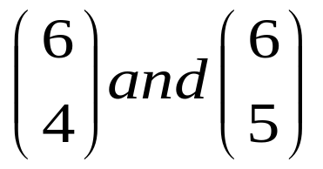
Pascal’s Triangle – Example 2
Use Pascal’s triangle to compute the values of
Answer
C(n+1,k) = C(n,k-1) + C(n,k)
Let n+1 = 6, and k = 4, then k = 5
C(6,4) = C(5,4-1) + C(5,4) = 10+5 = 15
C(6,5) = C(5,5-1) + C(5,5) = 5+1 = 6

Slide 19
Topics covered
Binomial Theorem
Pascal’s Triangle

